Slide 1


Needs and Wants
Second graders have been learning the difference between needs and wants throughout the school year.

Slide 2
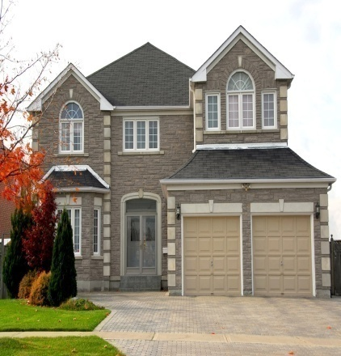
What Is A Need?
A need is something you must have in order to live.
The three basic needs are:
food, shelter, and clothing
Without these three things it will be very hard to live.

Slide 3

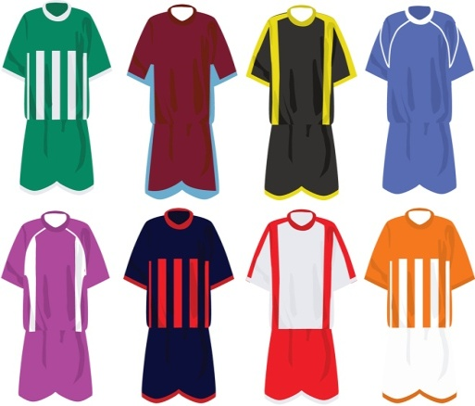
Three Basic Needs
Food
Shelter
Clothing

Slide 4
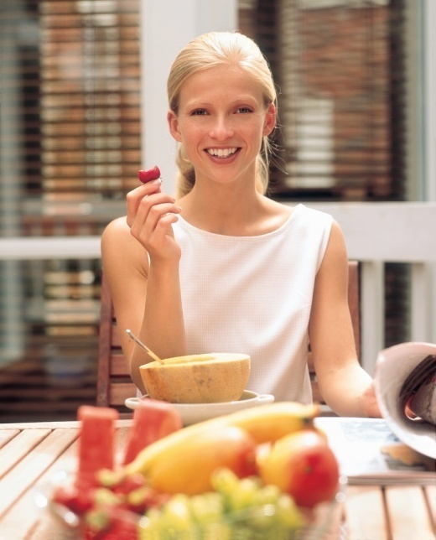
Food Is A Need
Without food we wouldn’t be able to live.
Food helps our bones grow stronger.
Some people may only get one meal a day, be thankful if you have three meals a day.

Slide 5

Shelter Is A Need
We need shelter to keep us safe and protect us from the weather.
Shelter is something that someone lives in.

Slide 6

Different Types Of Shelter
People live in many different kinds of shelter such as:
a house, an apartment, a trailer, or a farmhouse.

Slide 7
Clothing Is A Need
Clothes protect our body from any harm.
They keep us warm in the winter.
They keep us cool and protect us from the sun in the summer.

Slide 8
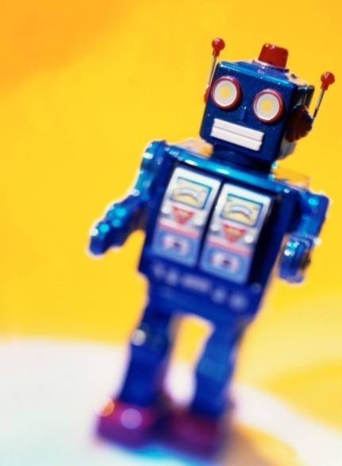

What Is A Want?
A want is something that people don’t need in order to survive.
On your birthday or Christmas we ask for lots of things we don’t need such as: toys, games, and pets.

Slide 9

Remember wants are things we wish we could have, but don’t need to survive.
.

Slide 10
Needs and Wants
If you want to learn some more about needs and wants click on the yellow link below the blue arrow.
It is a PowerPoint on needs and wants.
http://www.wisc-online.com/objects/index_tj.asp?objID=ABM3302

Slide 11
Let's Test Your Knowledge!
On the following slides it is going to ask you questions on needs and wants.
Test your knowledge to see what you know about needs and wants.
Good luck!

Slide 12
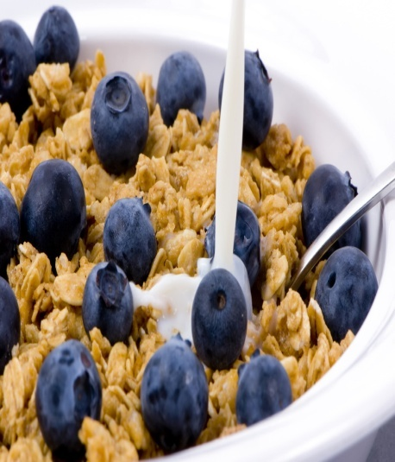
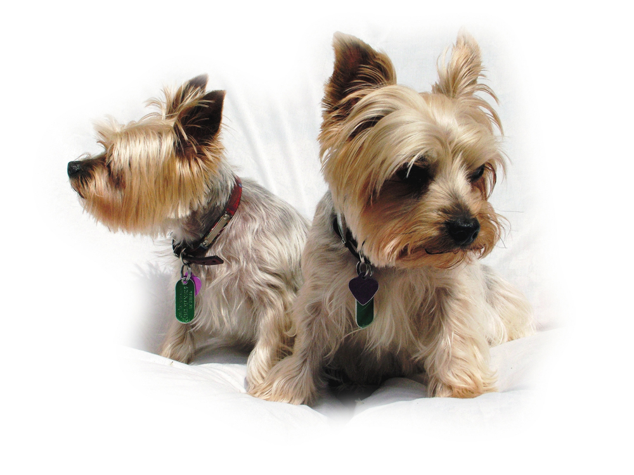
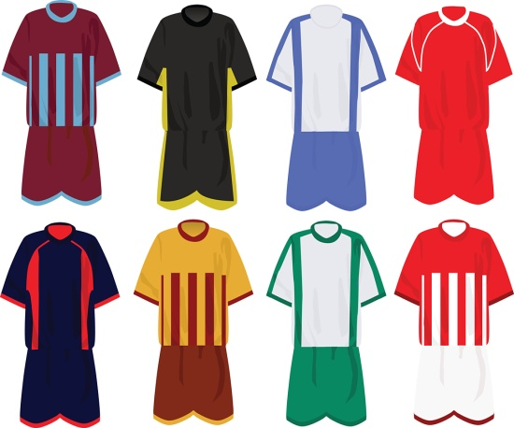

Which one is not a need?

Slide 13

Try Again
Remember a need is: food, shelter, and clothing.
Try again and see which one is not a need.

Slide 14
Correct!
You are right! A dog isn’t a need it is something that you want!

Slide 15



Which one is not a want?

Slide 16
Try Again
Remember a want is something that you want to have, but don’t need in order to survive.
Wants are things such as: a game, an IPOD, or a pet.

Slide 17
Correct!
You are right clothing is not a want. Clothing is something we need to protect our bodies.

Slide 18
What are the three basic needs we must have to live?
A.) water, air, shelter
B.) food, shelter, clothing
C.) food, air, clothing

Slide 19
Try Again
Remember the three basic needs that we talked about.

Slide 20
Correct!
That’s right the three basic needs are: food, shelter, and clothing. Good Job!

Slide 21
Do you need a want to survive?
A.) Yes
B.) No

Slide 22
Try Again
Remember a want is something that you wish you could have, but you don’t need in order to survive.

Slide 23
Correct!
Way to go! You remembered that you don’t need a want in order to survive!

Slide 24
Always remember your needs and your wants!
By Hope Andres
2nd Grade
Identifying Needs and Wants

